Slide 1

Object Detection Using Yolov5, FasterCNN, SSD
Team Members:
1. MINGYO JEONG , G#01402966
2. JOHN STEPHEN GUTAM , G#01413212

Slide 2
Evaluation of Three Models Using COCO Dataset
Objective: To evaluate the performance of three object detection models, namely YOLOv5, Faster R-CNN, and SSD, using the COCO dataset's validation set. This evaluation aims to compare the accuracy and efficiency of these models in detecting objects across various categories present in real-world images.
Data: A COCO-labeled dataset is required for this evaluation. The COCO dataset is a large-scale object detection, segmentation, and captioning dataset containing over 200,000 labeled images across 80 object categories. It is widely used for benchmarking object detection algorithms.

Slide 3
Our Approach
Load the COCO dataset's validation set, including images and corresponding annotations.
Instantiate the three object detection models: YOLOv5, Faster R-CNN, and SSD.
Evaluate the performance of each model on the validation set using standard evaluation metrics such as mean Average Precision (mAP) and precision-recall curves.
Analyze and compare the results to determine which model performs best in terms of accuracy and speed.

Slide 4
Sample Data
COCO instance names: ['person', 'bicycle', 'car', ...]
Device to be used: cuda (if GPU available), cpu (otherwise)
Example evaluation results on a sample image:
YOLOv5: Detected 3 objects (car, person, bicycle)
Faster R-CNN: Detected 2 objects (person, car)
SSD: Detected 4 objects (car, person, bicycle, truck)

Slide 5
Evaluation Process and Visualization
Evaluation Method: Perform detection on each model with standardized transformations and confidence thresholding.
Data Visualization: Plot detections on sample images for visual comparison.
Evaluation Metrics: Compare accuracy, speed, and detection efficiency.

Slide 6
Key Functions:
perform_detection: Detect objects and convert detections to DataFrame.
detections_to_dataframe: Convert detections to DataFrame format.
plot_detections: Visualize detections on image.
plot_all_detections: Plot detections for all models on sample image.

Slide 7
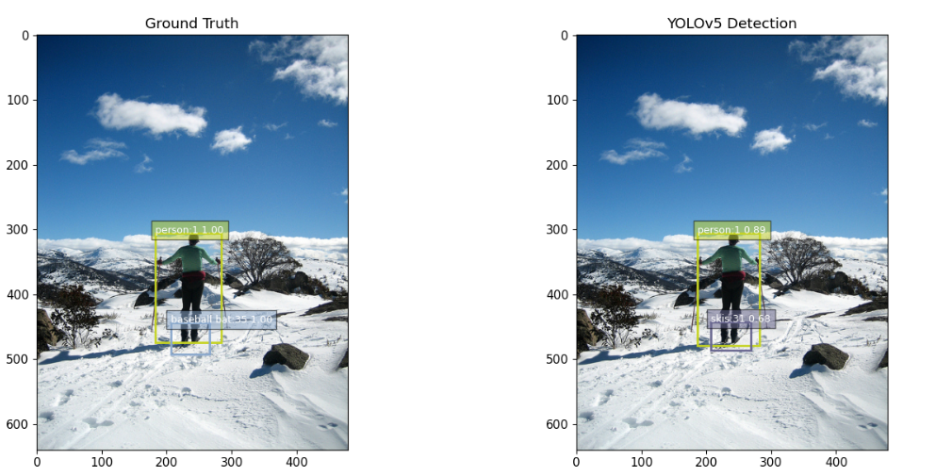
Output Detected Images

Slide 8
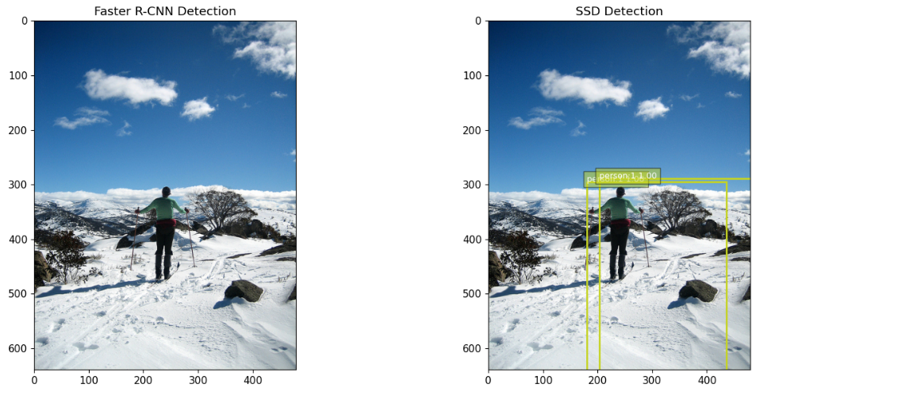

Slide 9
Conclusion and Recommendations
Conclusion: Evaluate and compare performance metrics of YOLOv5, Faster R-CNN, and SSD.
Recommendations: Based on evaluation results, YOLOv5 is the most suitable model for the use cases.
Future Work: Further optimization and fine-tuning for improved performance can be done.
Key Takeaways:
YOLOv5: Fast and accurate object detection.
Faster R-CNN: High accuracy with slightly slower inference.
SSD: Balanced performance suitable for real-time applications.

